Slide 1
Attentional Discounting in Gains, Attentional Amplification in Losses
Brenden Eum
Stephen Gonzalez
Antonio Rangel
*slides

Slide 2



Slide 3
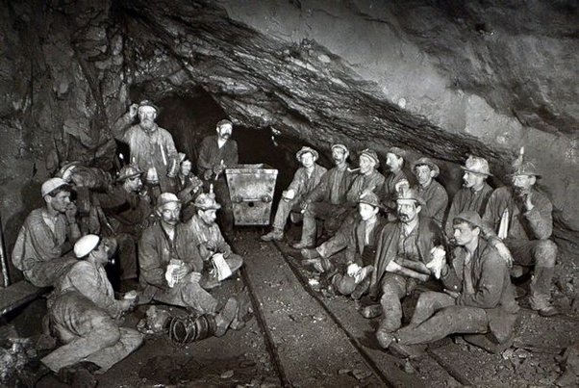

Slide 4
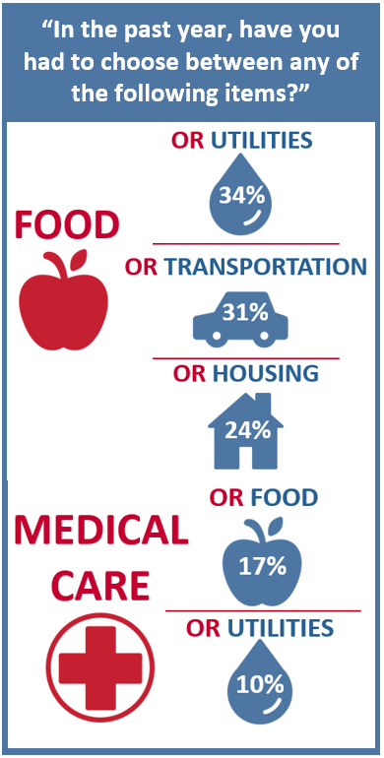
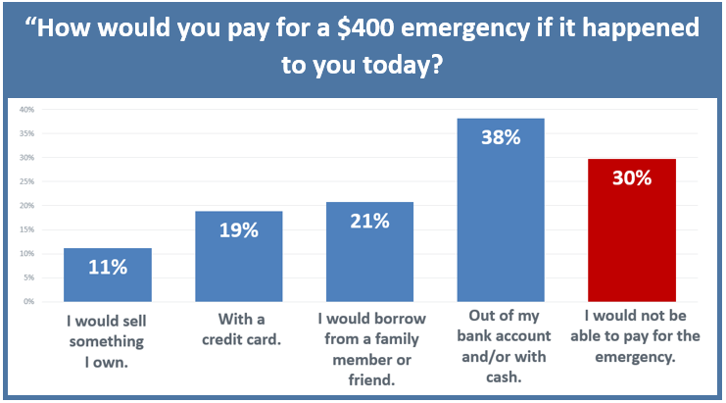
The Center for Community Solutions, Cleveland, Ohio

Slide 5


Mar 2023: GM offered 58,000 voluntary buyouts.
Apr 2023: 5,000 workers took the offer.
Notes:
Stay and risk wage and benefit cuts VERSUS take the offer but risk losing everything if the company declares bankruptcy.

Slide 6
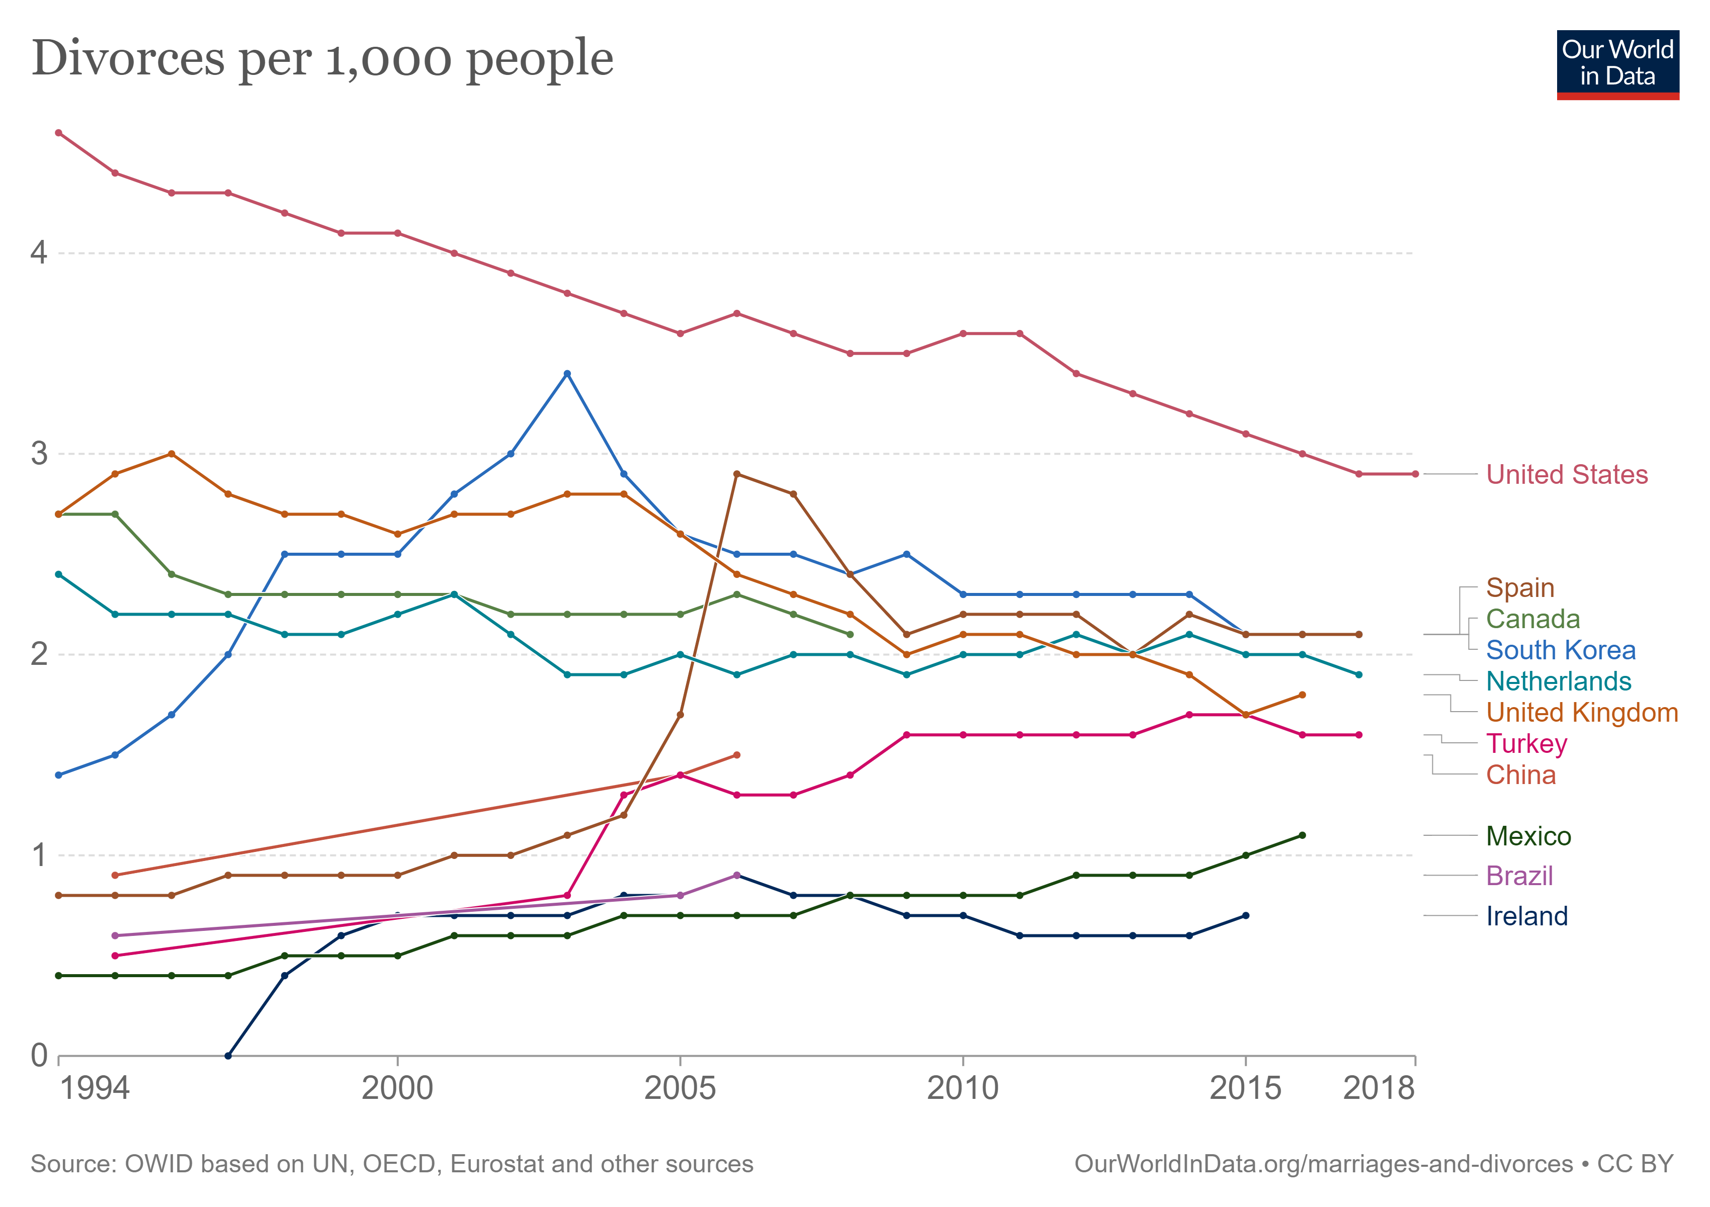


Slide 7
What are some factors, besides the (negative) values of the options, that affect choices between losses?

Slide 8



Slide 9
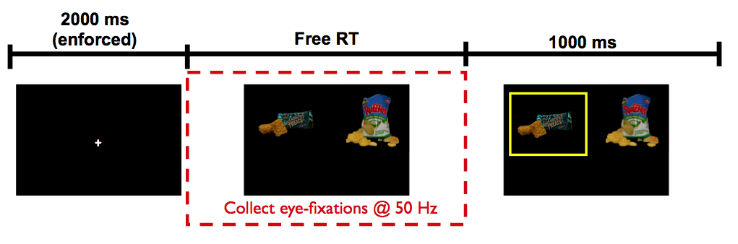
Krajbich, Armel, Rangel (2010, Nat Neuro)

Slide 10
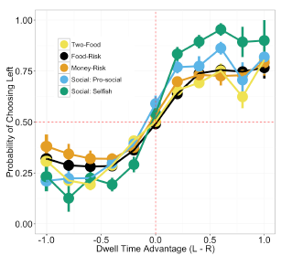
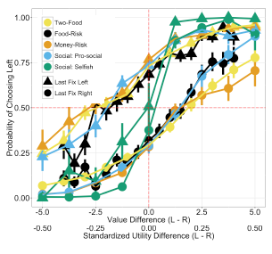
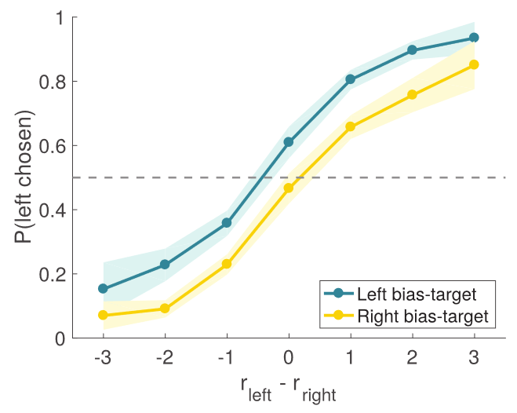
Net Fixation Bias
Last Fixation Bias
Causal
Smith, Krajbich (2018, J Exp Psychol Gen)
Tavares, Perona, Rangel (2017, Front Psychol)
Notes:
multiple domains

Slide 11
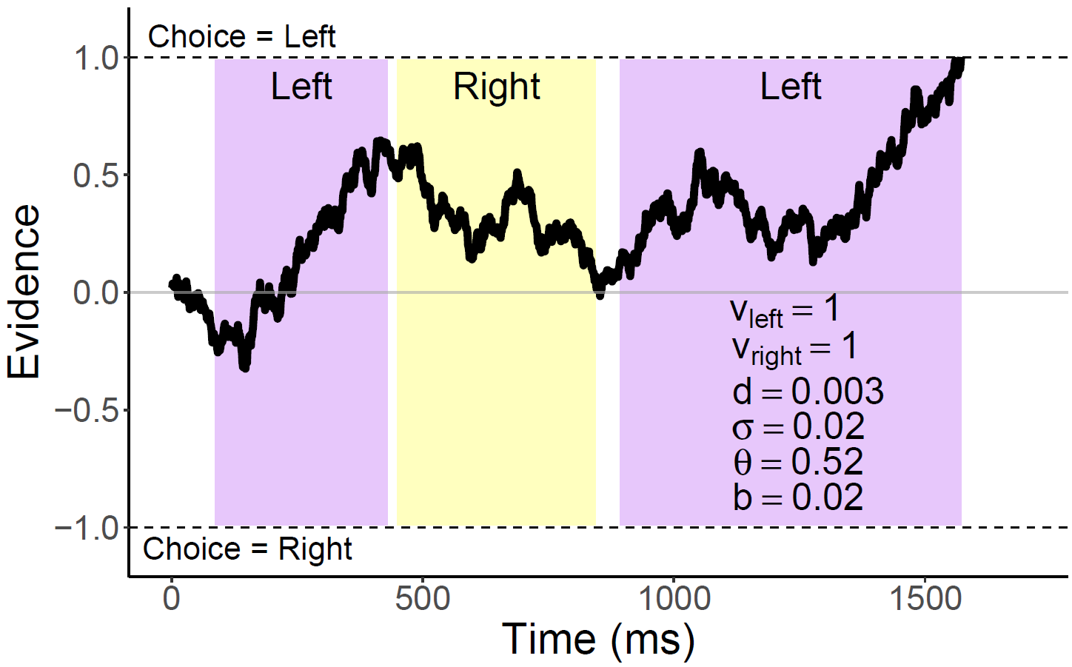
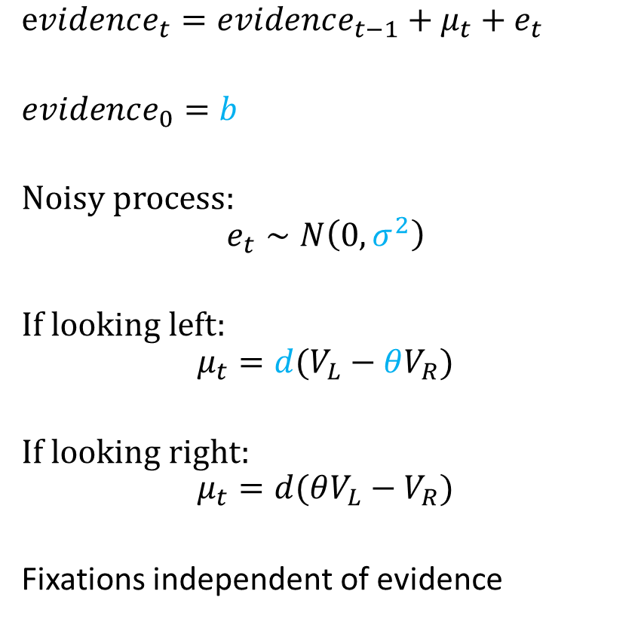
Attentional Drift-Diffusion-Model (aDDM)
$evidence_{t}=evidence_{t−1}+μ_{t}+e_{t}$
$evidence_{0}=b$
Noisy process:
$$e_{t}∼N\left(0, σ^{2}\right)$$
If looking left:
$$μ_{t}=d(V_{L}−θV_{R})$$
If looking right:
$$μ_{t}=d(θV_{L}−V_{R})$$
Fixations independent of evidence
Krajbich, Armel, Rangel (2010, Nat Neuro)
Eum, Dolbier, and Rangel (2023)
Notes:
noisy
bias
drift: ddm in value based decisions: evidence accumulated is value comparison
drift
sim
explain fixation sampling process

Slide 12
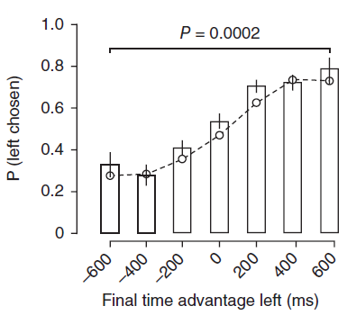
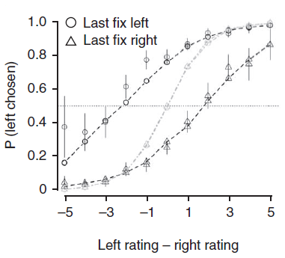
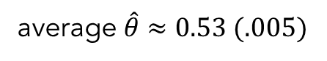
aDDM Predictions
average $\hat{θ}≈0.53 (.005)$
1. Attentional Discounting
2. Net Fixation Bias
3. Last Fixation Bias
Bhatnagar, Orquin (2022, J Exp Psychol Gen)
Krajbich, Armel, Rangel (2010, Nat Neuro)

Slide 14
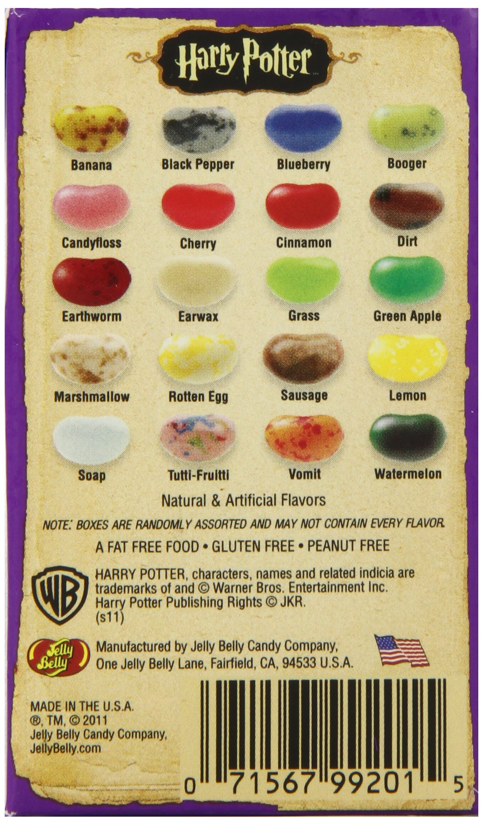

Slide 15
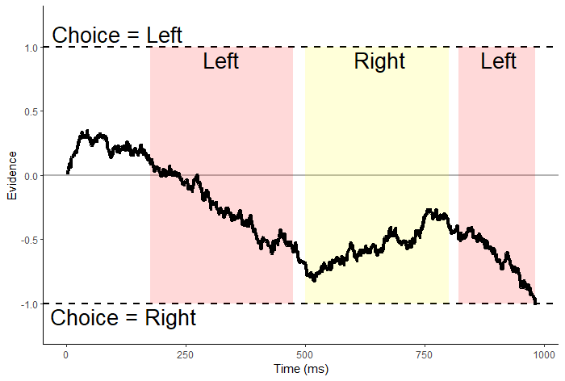
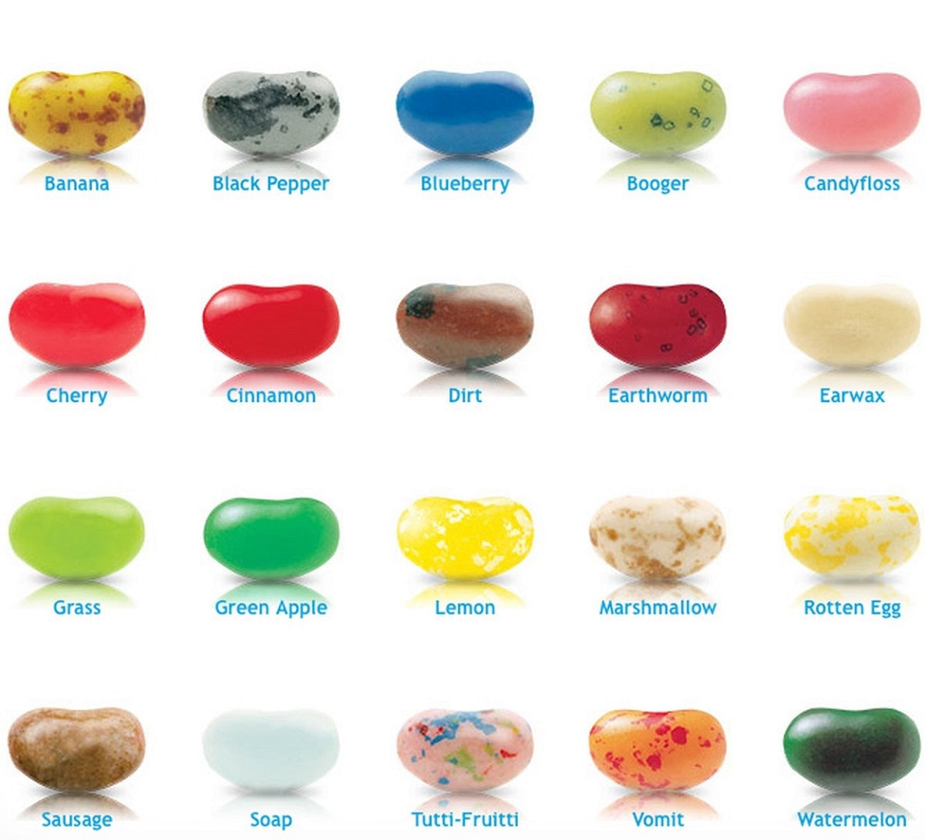

Slide 16
If attentional discounting is stable, then in choices between losses, attentional discounting of the nonfixated option value should make it seem better than it is.

Slide 17
Attentional choice biases should flip.
Net fixation bias
Last fixation bias
Last fix. right
Last fix. left
P(left chosen)
P(left chosen)
Final time advantage left (ms)
Left rating - right rating

Slide 18
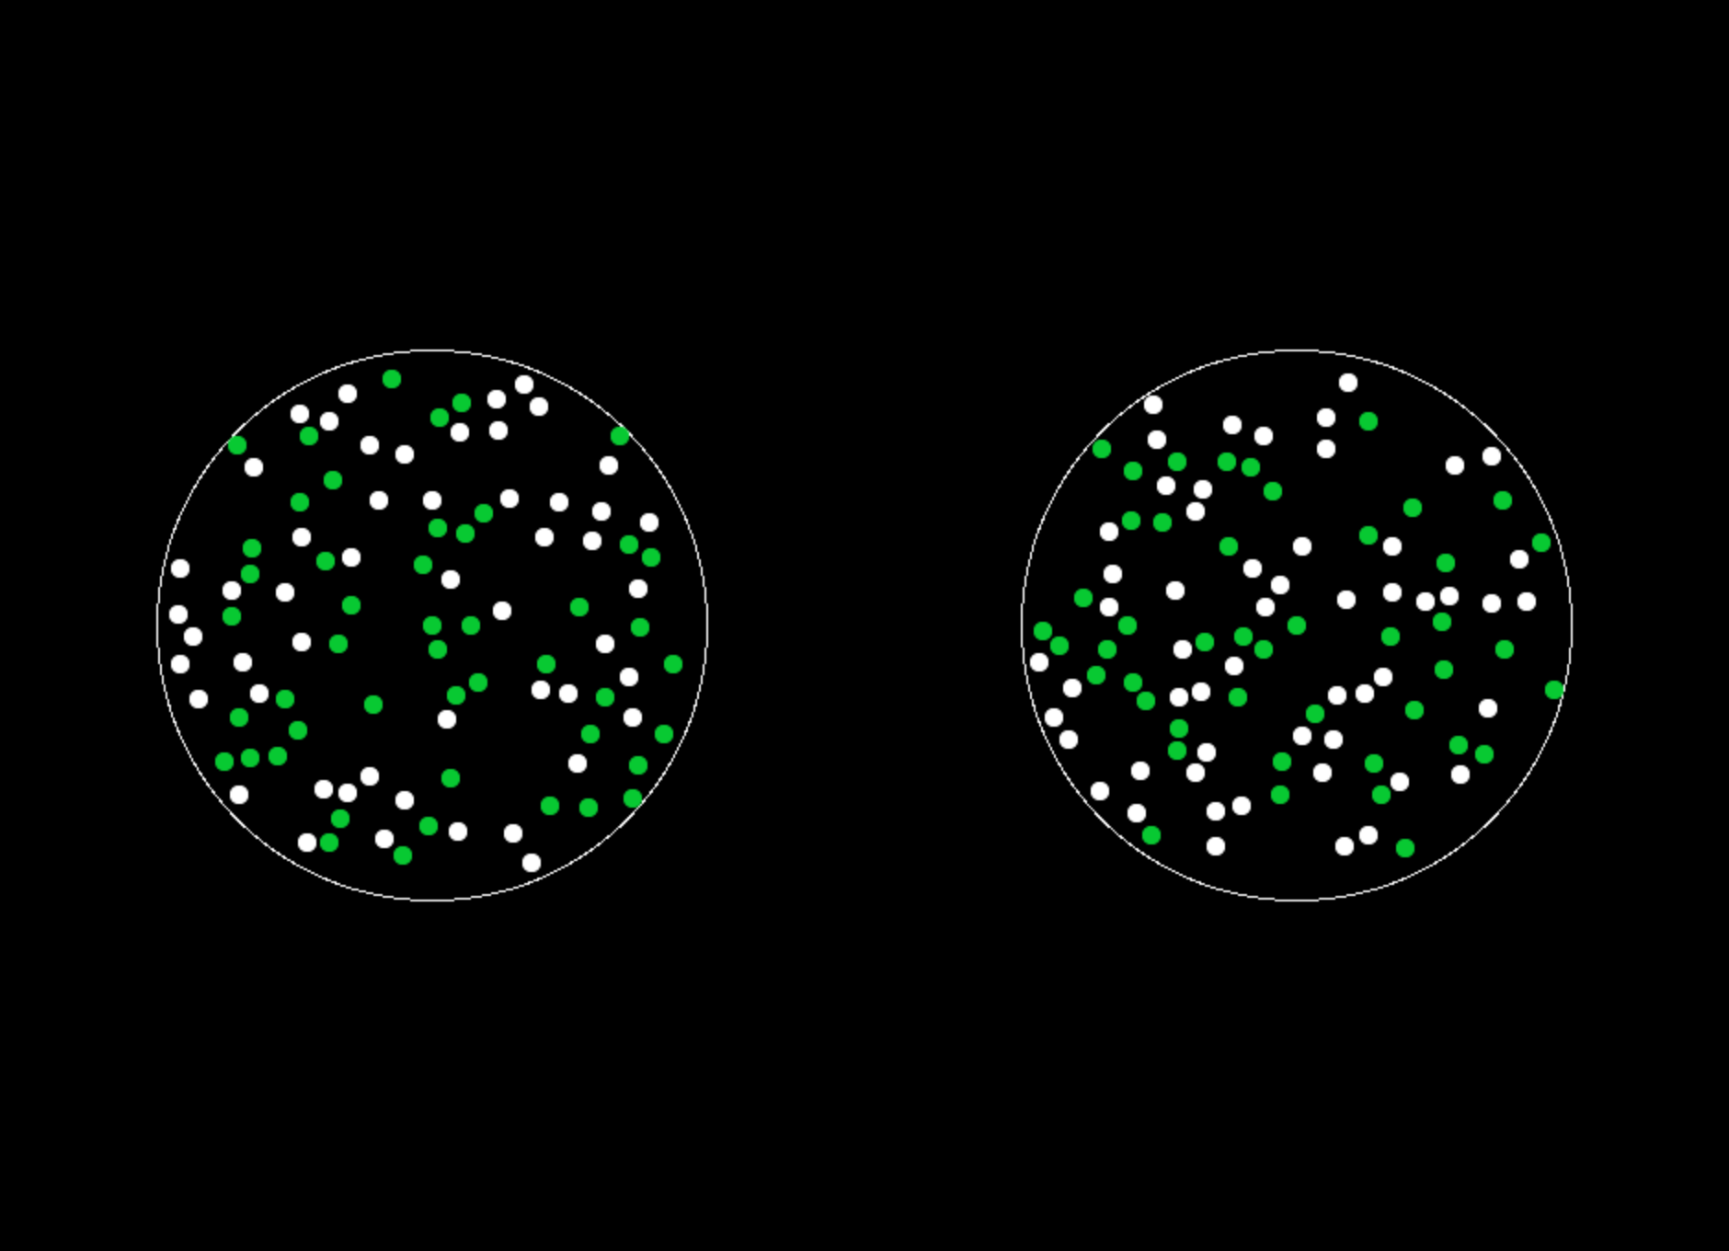
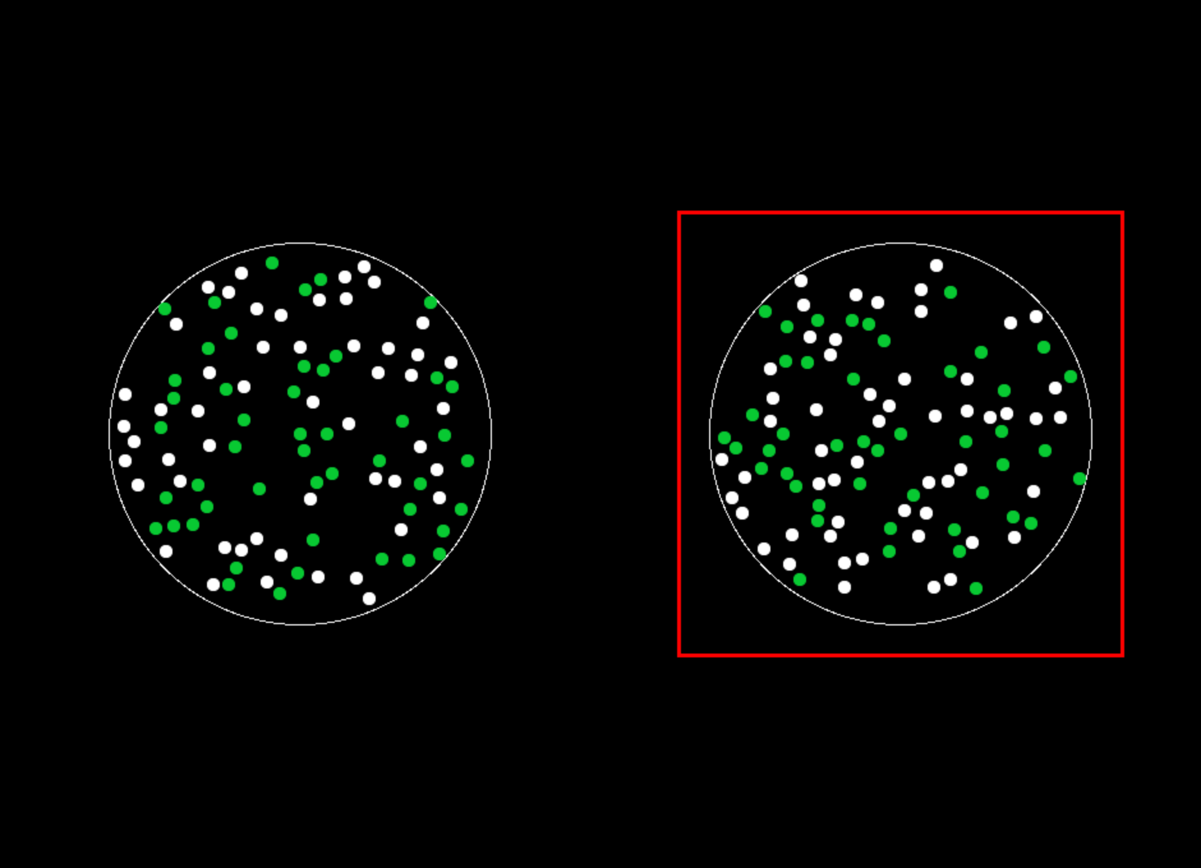

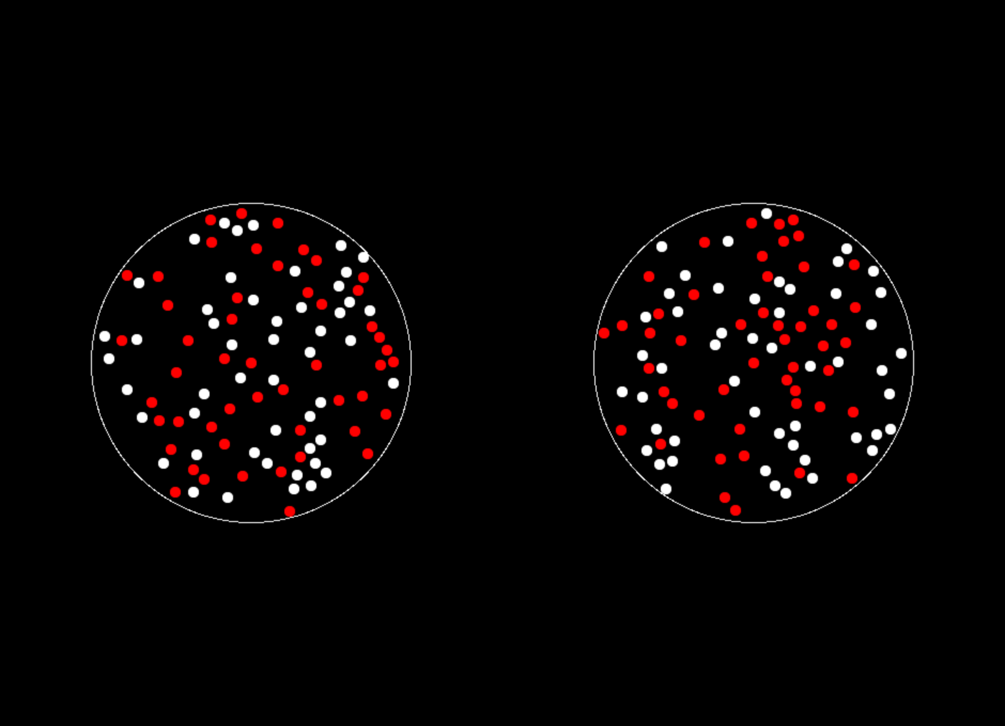
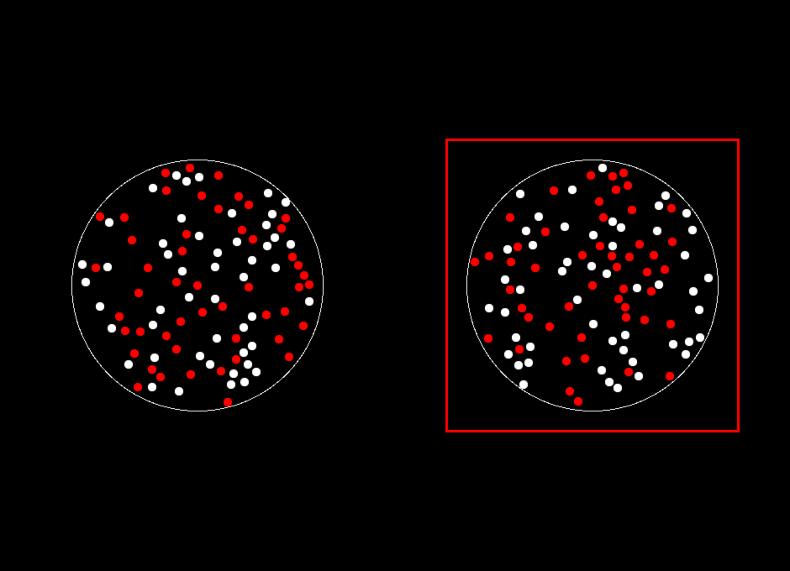
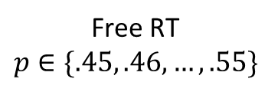
Gain
Loss
ITI
1 s
Free RT
$$p∈\{.45, .46, …, .55\}$$
Feedback
1 s
Eye-tracking

Slide 19
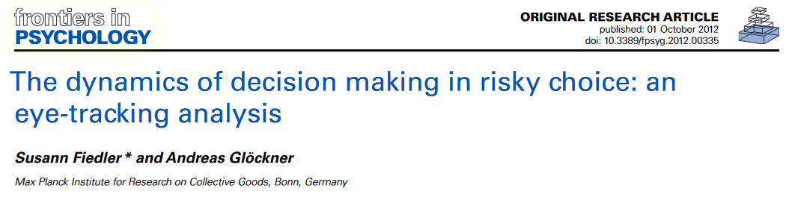
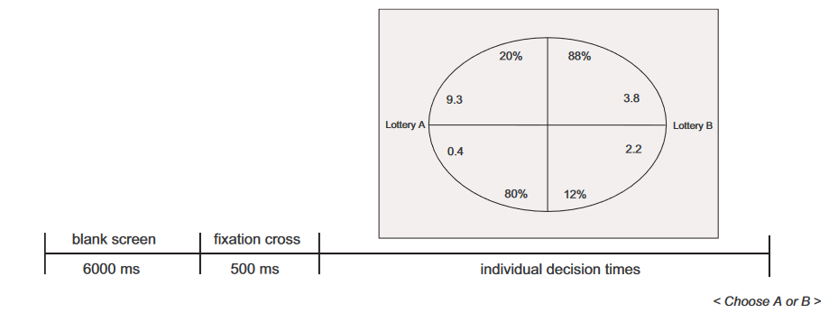

Slide 20
Inference Strategy
Joint Dataset
Exploratory Sample
N = 30
400 trials
Confirmatory Sample
N = 30
400 trials

Slide 21
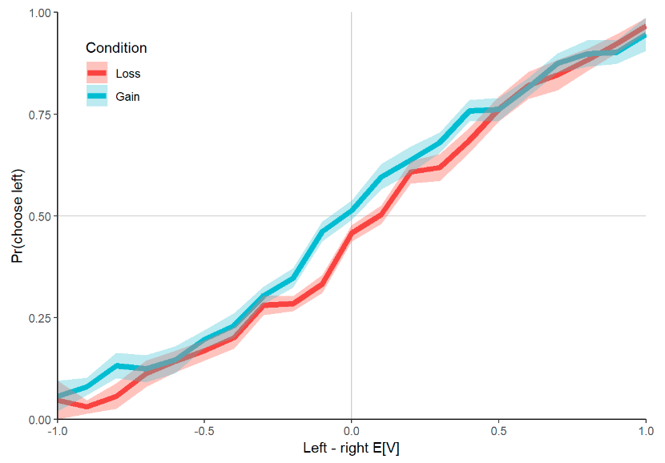
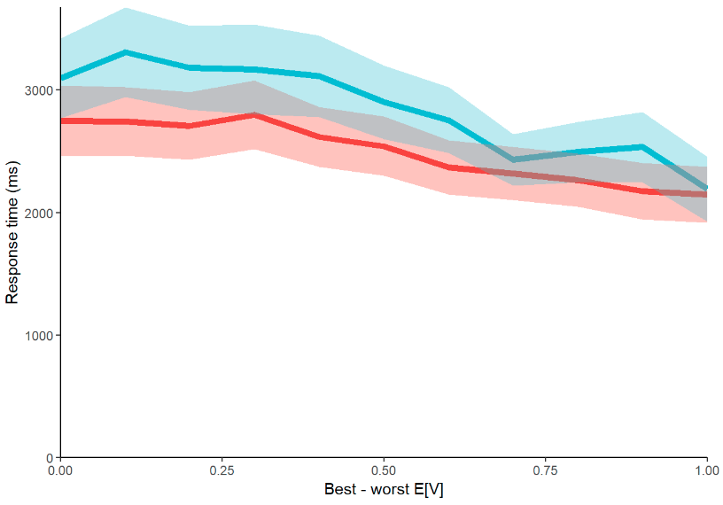
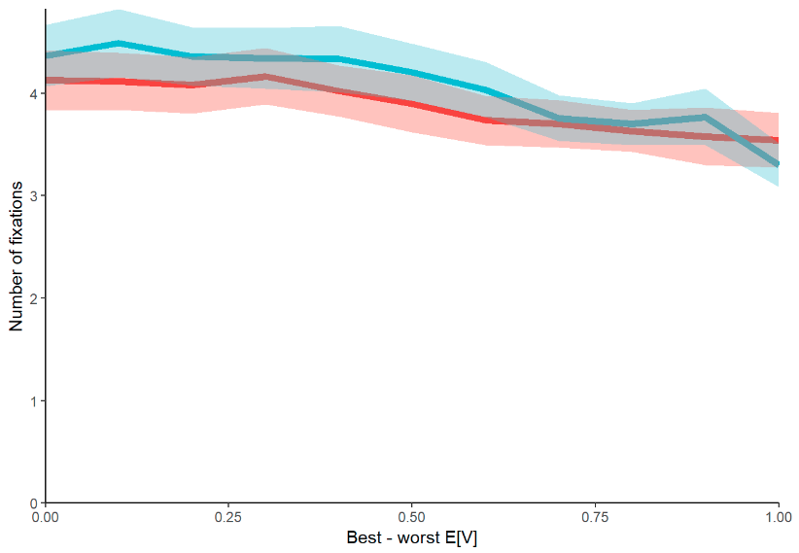

Psychometrics

Slide 22
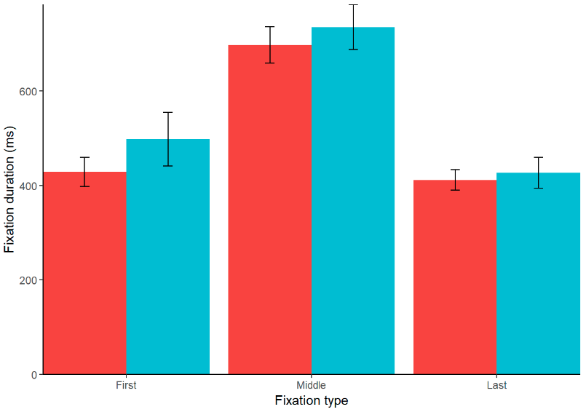
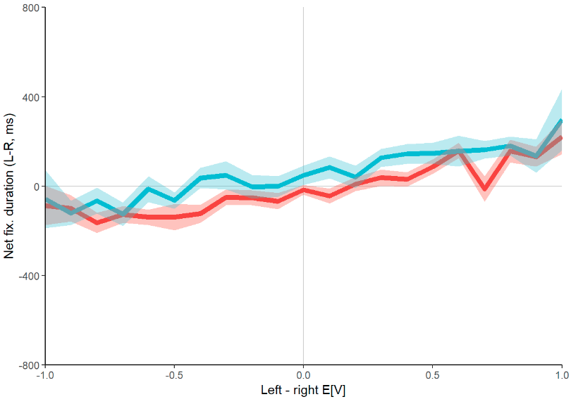
Fixation Properties

Slide 23
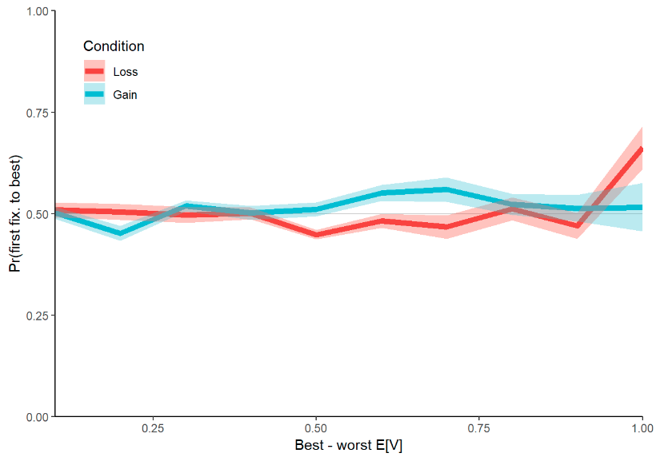
Fixation Sanity Checks

Slide 24
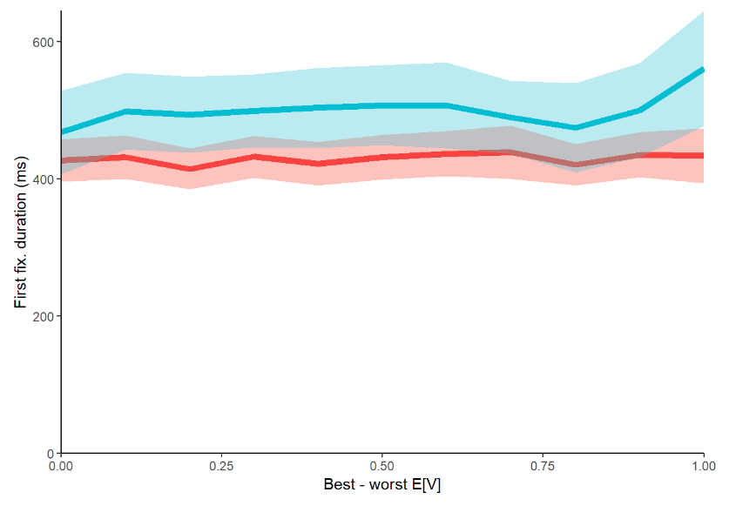
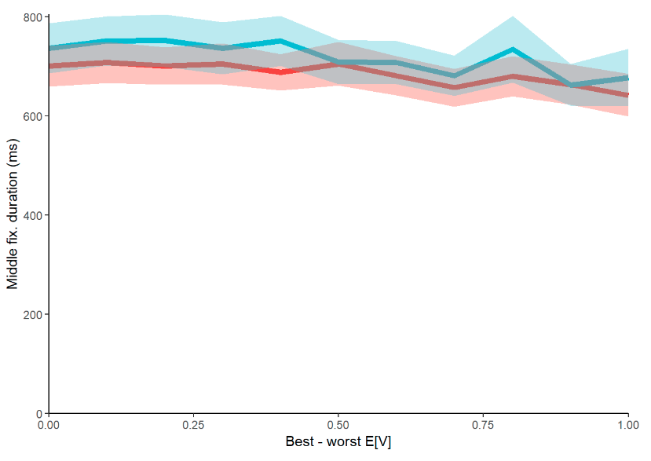
First and Middle Fixations

Slide 25
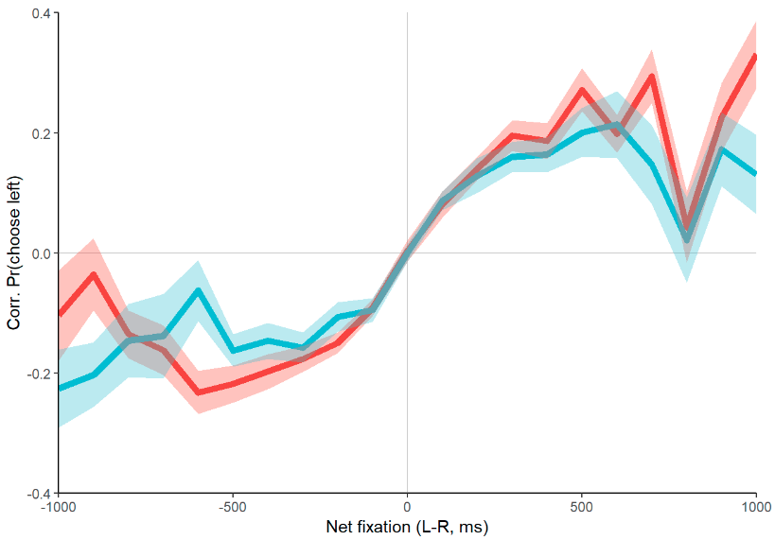
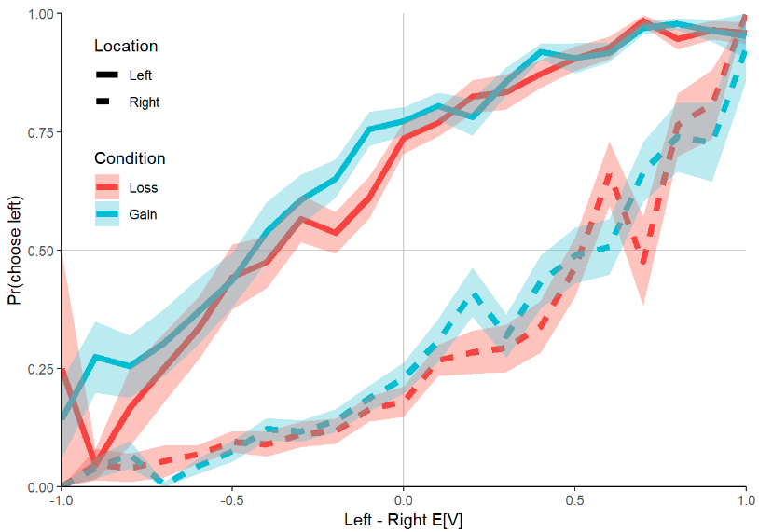
Attentional Choice Biases

Slide 26
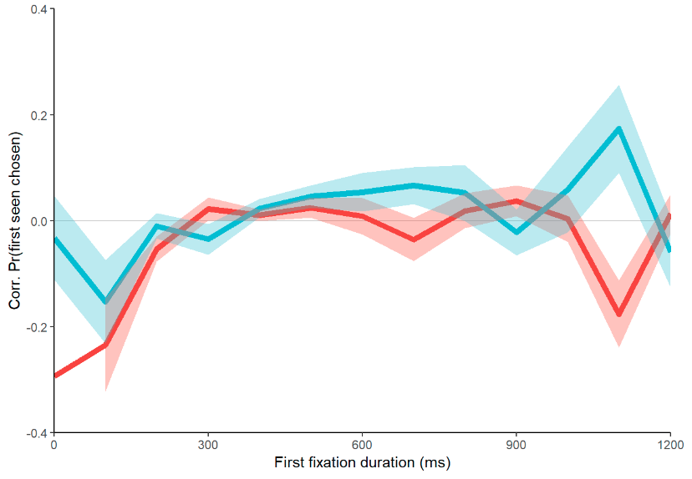
First fixation bias

Slide 27
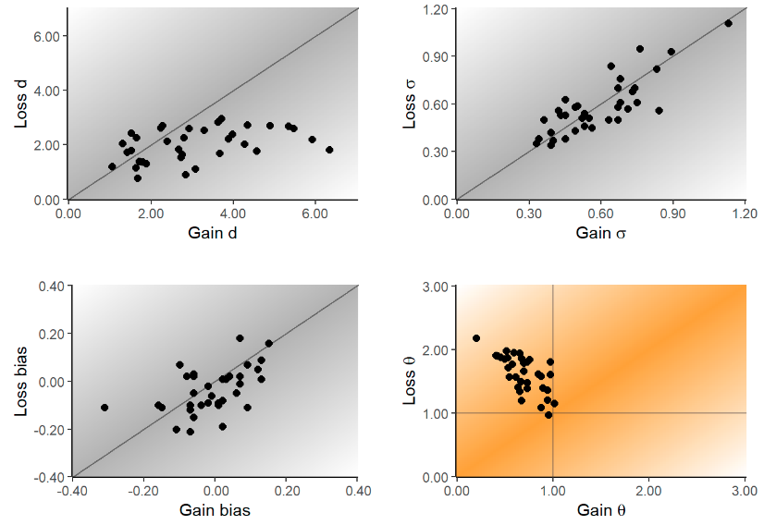

Attentional Discounting in Gains, Attentional Amplification in Losses

Slide 28
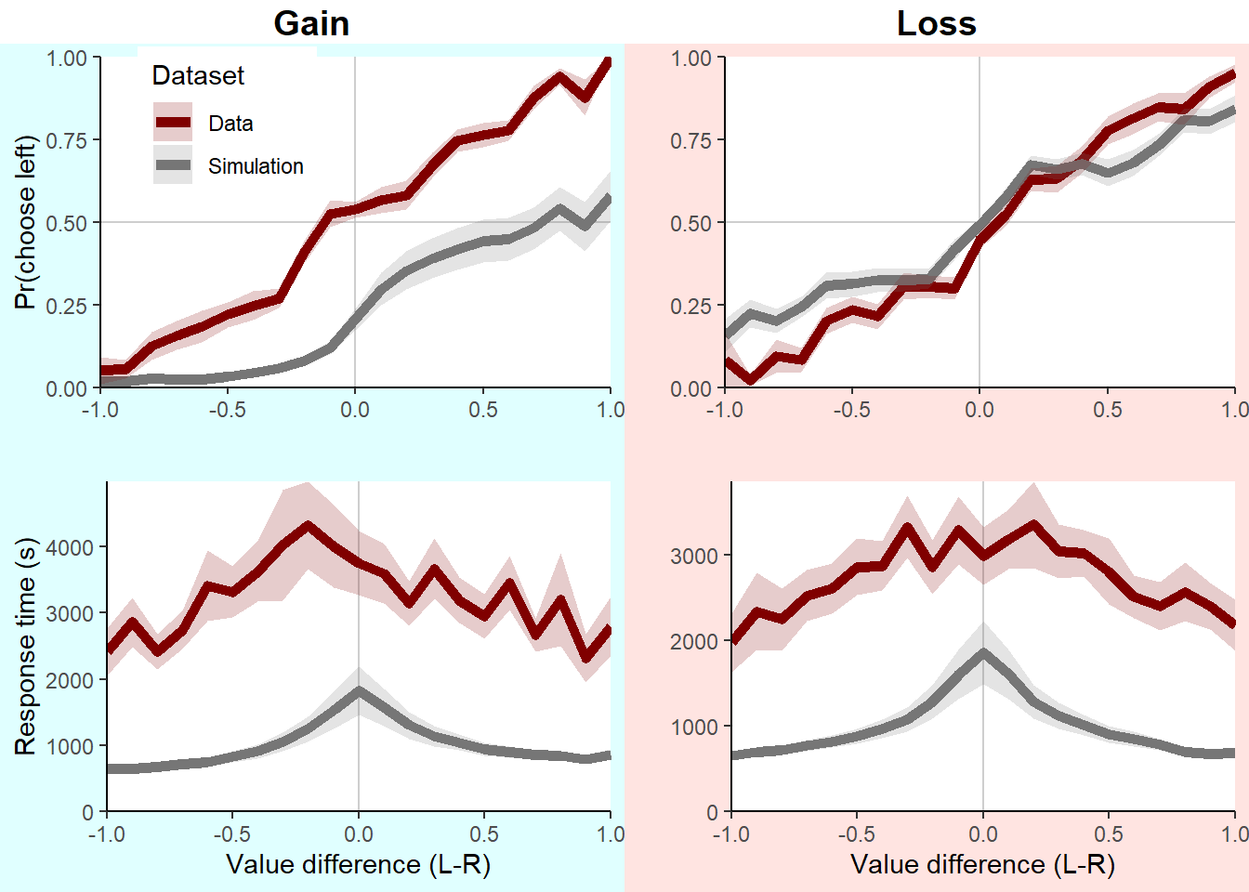

Slide 29
Possible Explanations
There is a fundamental difference in the role of attention in choices between losses than in choices between gains.
Subjects may be solving the task by counting the number of green dots in gains, but counting the number of white dots in losses.
Subjects are evaluating the value of the options with respect to a reference point, e.g. the minimum of the two options.

Slide 30
Next Steps
Shifting to choices between two lotteries with numerical representations.
$14.95
43.97%
$12.69
55.76%
-$8.12
78.43%
-$10.18
67.65%
E[V]=6.57
E[V]=7.08
E[V]=-6.37
E[V]=-6.88

